Slide 1
Cybersecurity Exploration Game
Team Name: CyberExplorers
Hitchcock, Brian, bkh3@hood.edu
Urban, Julian, jdu1@hood.edu
3/28/2023
https://github.com/thejduman/UrbanHitchcock-CapstoneDungeon/tree/main

Slide 2
The Project
A 2D exploration game that teaches players about cybersecurity
Developed in Unity/C#
Multiple areas to explore
Collect journal entries containing information about cybersecurity
Players are quizzed on this information in question trials
The player must get a passing grade to proceed to the next area
Each area has harder questions than the previous area
Game ends once the player has cleared all areas

Slide 3
System Features
Movement
Interact command
Saving progress
Map
Journal pages
Menu
Question trials

Slide 4

Background
Similar to capture-the-flag games
Example - National Cyber League
Questions are split into categories
Points for answering questions correctly
Questions require technical skill and use of external software tools
Competitive - which team/individual can get the most points
Different from our project
More focused on education
Multiple-choice questions only
More than just a quiz game - features environments the user can explore

Slide 5

Background - another example
The Missing Link from Texas A&M
Player analyzes emails to determine if they are phishing
Objective is to determine what led to the disappearance of a social media influencer
Different from our game
Covers more aspects of cybersecurity
Has environments for players to explore
Questions aimed towards people with a computer science background

Slide 6
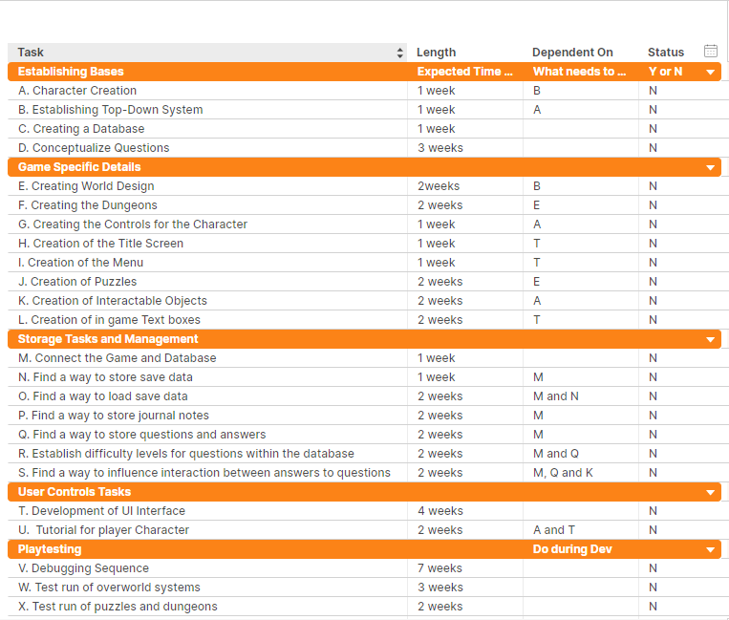
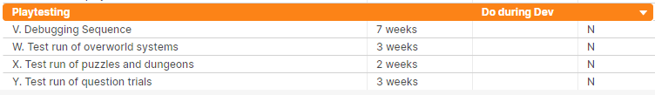
Project Plan
Original plan
Deviated from this plan slightly
Focused more on functionality instead of visual polish

Slide 7
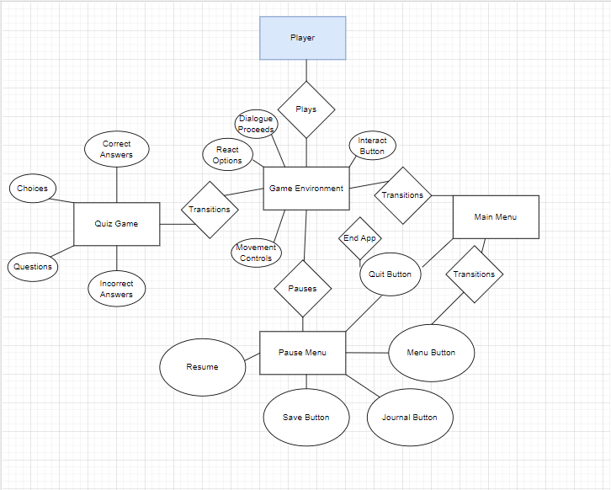
Technical Description
Current Proceeds
Future Journal Procedures
Establishment of more objects

Slide 8
Accomplished Work
A player character with basic movement
Dialogue box with responses
Object interaction
Interaction triggers an action in the game
Quiz game
Pause menu
Main menu

Slide 9
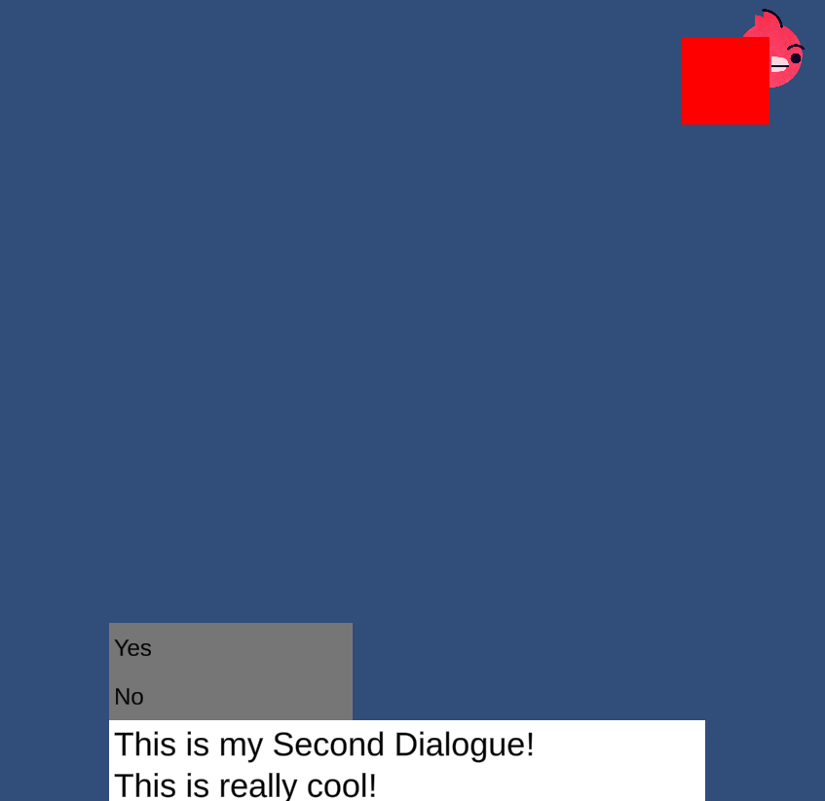


Dialogue Boxes
Creation of Dialogue Objects
Player able to proceed through dialogue
Player able to choose a response
Game reacts to chosen option

Slide 10
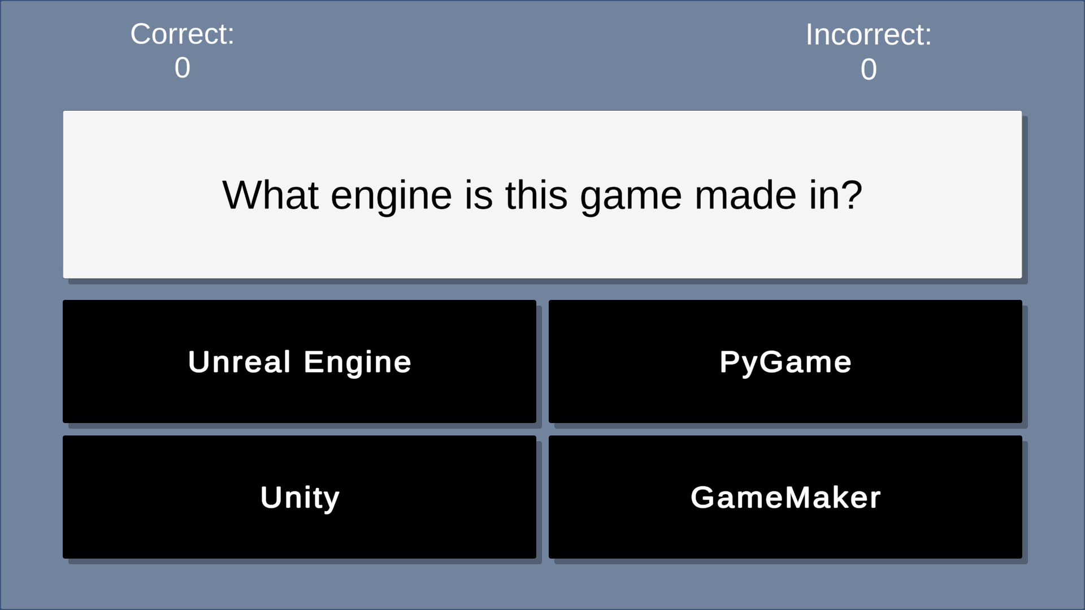
Quiz Game
Loading of questions from an array
Random selection of questions
Player selects an answer
Game checks if answer is correct
Tracking number of correct and incorrect answers

Slide 11
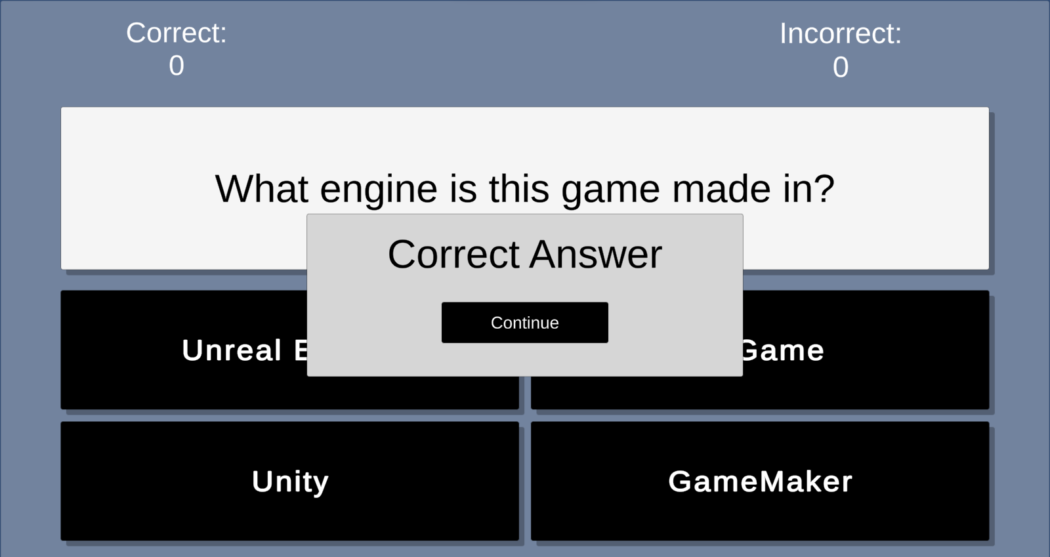
Status
Quiz Game
Menus
Objects/Interactions

Slide 12
Effort
Agile Development
Clockify, Trello
Brian’s Contributions | Julian’s Contributions
General Planner/Delegator of Tasks | Team Liason
Developed Menus and Dialogue Systems | Developed Quiz Game

Slide 13
Lessons Learned
Editor/Build graphics comparison
Merging of Works
Where to direct Focus
How much one should contribute

Slide 14
Expected Forthcoming Activities
Insertion of Graphic Assets
Insertion of more objects (NPCs, Journals, Structures)
Development of more scenes/locations
Refinement of Player Controls
Development of Questions for the Quiz Game
Development of Database to store information and data

Slide 15
Expected Forthcoming Activities
Insertion of Graphic Assets | Intend via Unity Asset Store | To be done by Both
Objects/Scenes/Locations/Controls | Code in C#, Modifications in Unity Editor | To be done by Brian
Question Conceptualization | External Research | To be done by Julian
Storing of Data/Information | SQLite, Code in C#, Tie Ins with Unity Editor | To be done by Both

